Slide 1
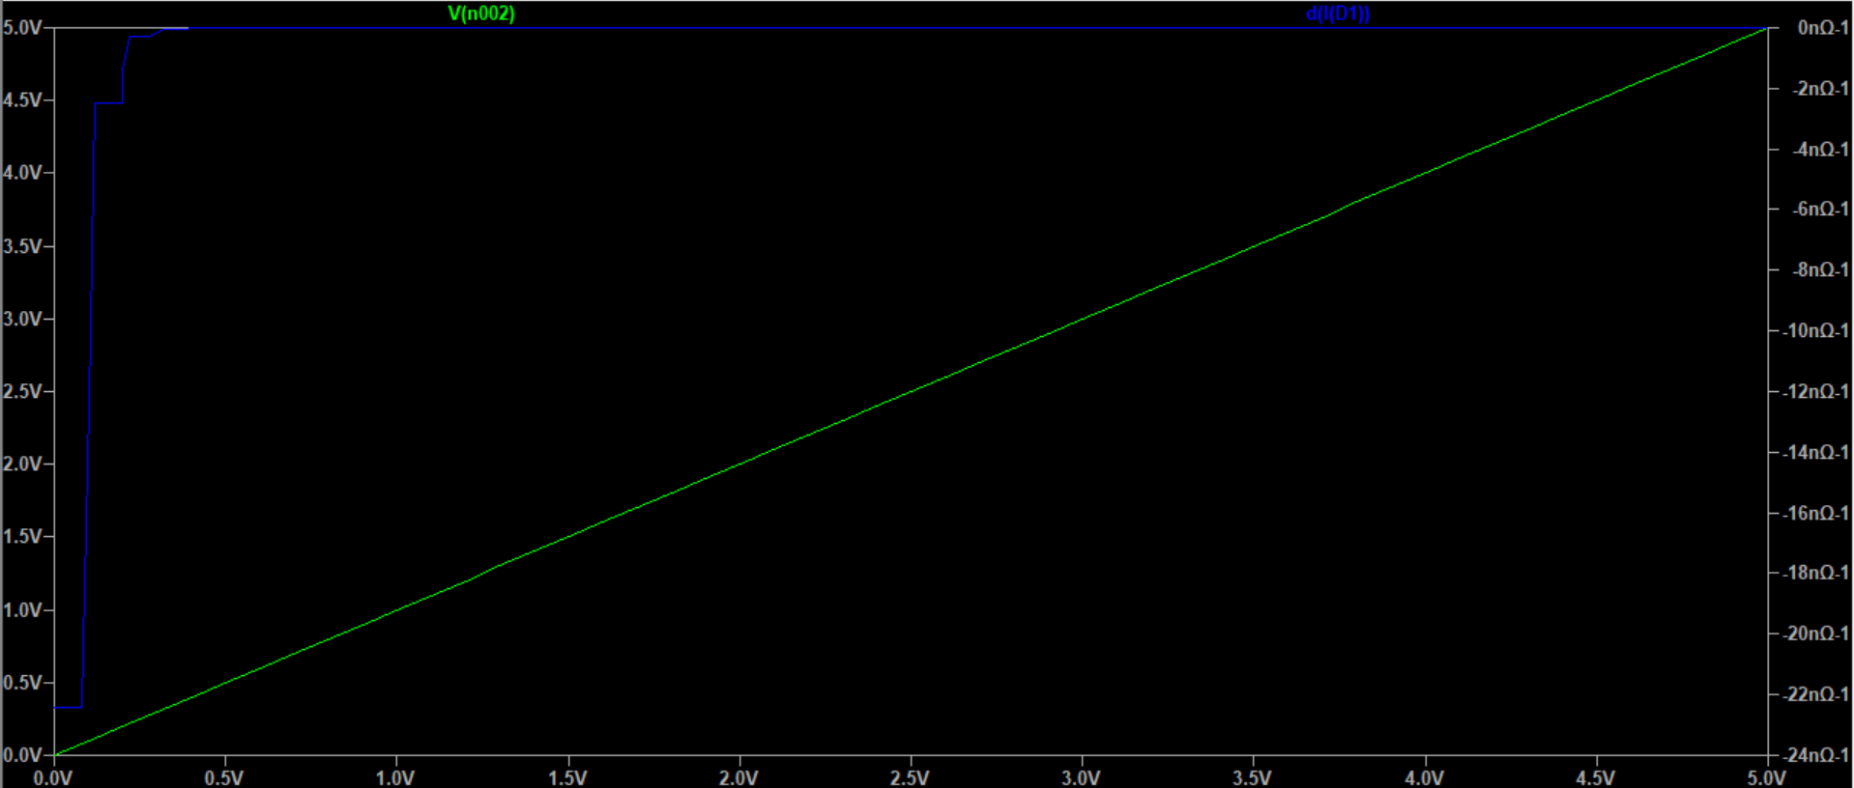
Exercise E3
When $V>0.7V$, $\frac{1}{R}=−1.039p Ω^{−1}$, $R=9.62×{10}^{11}Ω$

Slide 2
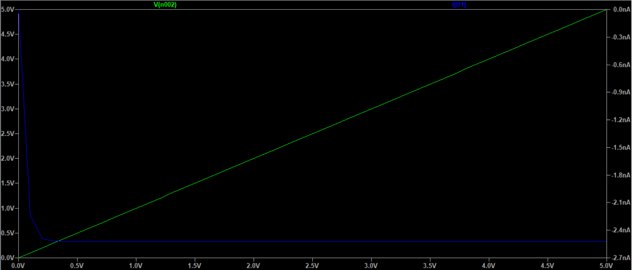
Exercise E3
Leakage current: when $V=5.0V$, $I=−2.525nA$. Negligible.

